Slide 1
Programming Languages Constructs in Assembly
Slides: Thanks to S. Bowne

Slide 2
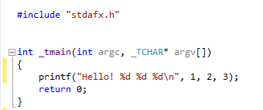

Function Call

Slide 3
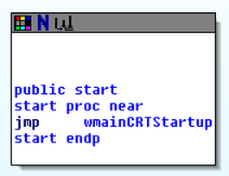
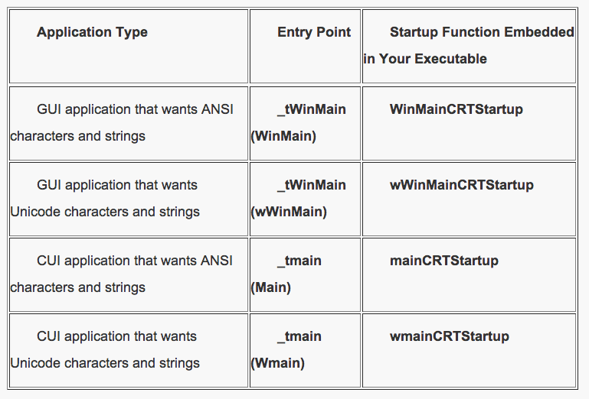
Finding the Code in IDA Pro
IDA shows only the entry point
Link Ch 6a

Slide 4
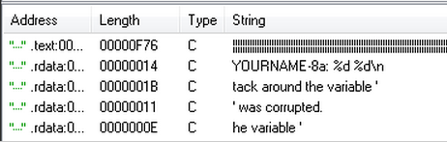
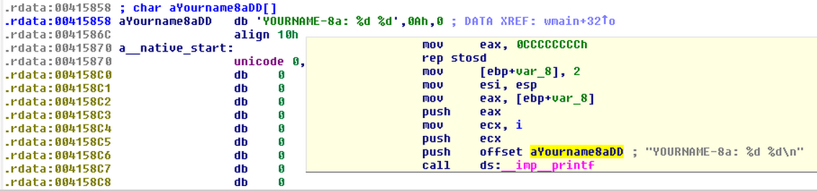
Trick: Use Strings, then XREF

Slide 5
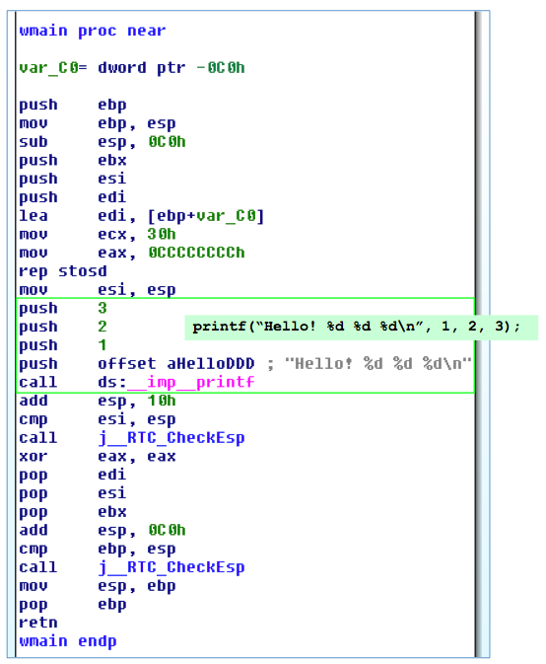
Disassembly in IDA Pro
4 arguments for printf() function
Pushed onto stack
Reverse order
call launches function

Slide 6
Global vs. Local Variables
Global variables
Available to any function in the program
Local variables
Defined in a function and only available to that function

Slide 7
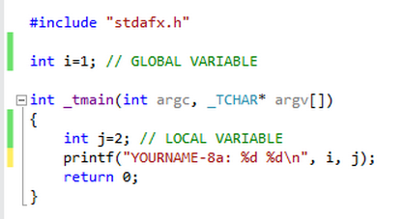
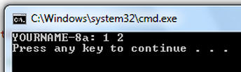
Global vs. Local Variables

Slide 8
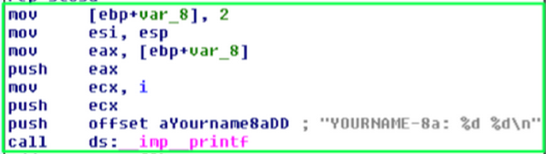
Global vs. Local Variables
Local – on stack
Local – on stack
Global – in memory

Slide 9
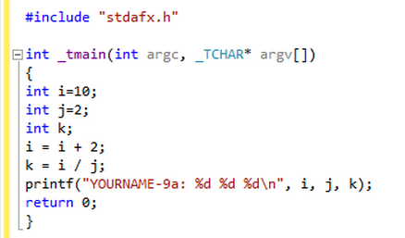
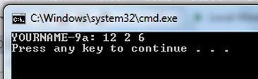
Arithmetic Operations

Slide 10
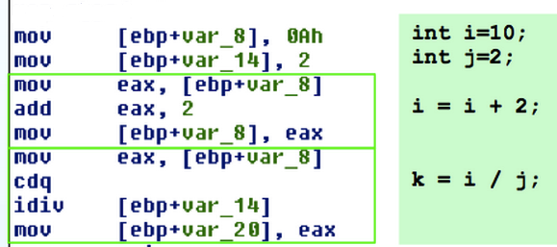
Arithmetic Operations

Slide 11
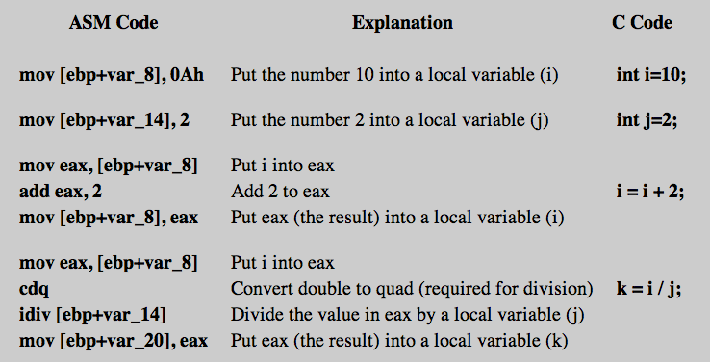
Arithmetic Operations

Slide 12
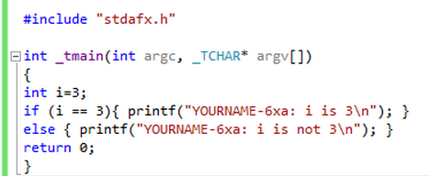
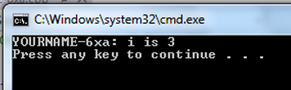
Branching (if)

Slide 13
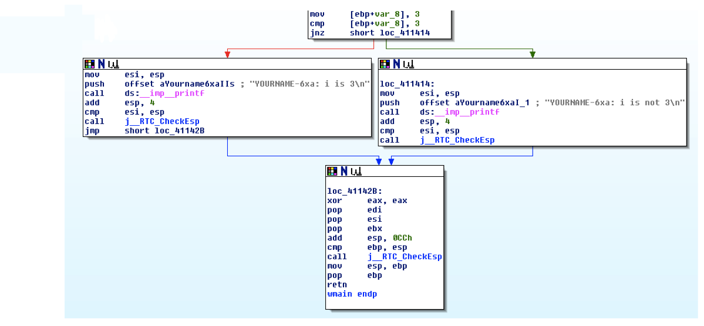
Branching (if)

Slide 14
Summary
Finding the Code
Strings, then XREF
Function Call
Arguments pushed onto stack
Reverse order
call
Variables
Global: in memory, available to all functions
Local: on stack, only available to one function

Slide 15
Summary
Arithmetic
Move variables into registers
Perform arithmetic (add, sub, idiv, etc.)
Move results back into variables
Branching
Compare (cmp, test, etc.)
Conditional jump (jz, jnz, etc.)
Red arrow if false, green arrow if true

